Slide 1
Machine Learning
Ensemble Methods & Time Series Notes

Slide 2
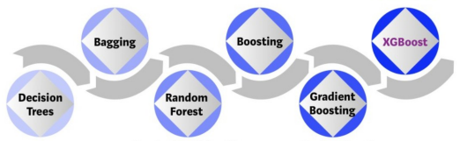
Ensemble Methods
Idea: The combination of multiple estimators (Classifier/Regressor) is better than a single estimator (e.g., Random Forest is better than a single Decision Tree).
Estimators are typically decision trees, but any algorithm can be used (e.g. Linear/Logistic Regression, even Neural Networks).

Slide 3
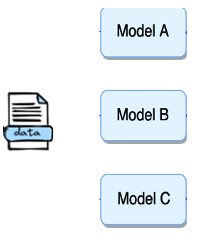
Voting
Train multiple estimators of different models (algorithms) in the same training set.
For each new instance:
  Each estimator generates an output.
  The final output is decided using hard or soft voting.
Hard Voting: The output becomes the majority vote (Classification only).
Soft Voting:
  Classification: Each estimator produces a probability of the instance belonging to a specific class. Then, we compute the average probability for each class. Finally, we select the class with the highest average probability.
  Regression: The output is the average output value of all regressors.
Hard/Soft Voting

Slide 4
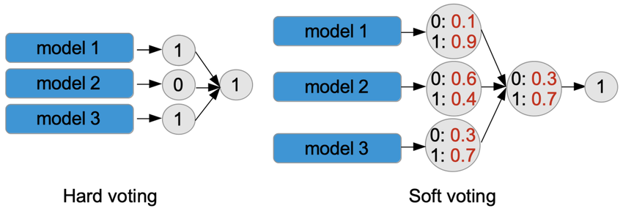
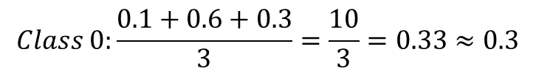
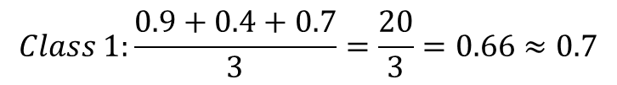
Hard vs Soft Voting Classification Example

Slide 5
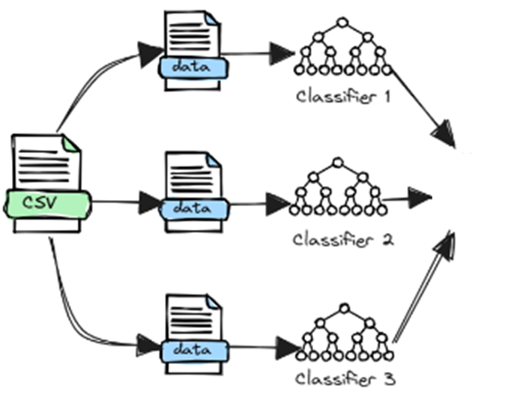



Bagging
Combines multiple estimators of the same algorithm.
Each estimator is trained on a subset of the initial training set (different samples/observations). The subsets are created using sampling with replacement.
For each new instance, each model produces an output. Then, we calculate the final output as below:
  Averaging: The average value of all estimators (Regression).
  Majority Vote: The class with most of the votes (Classification).
Hard ή Soft
Voting

Slide 6
Voting vs Bagging
Settings | Voting | Bagging
Estimators | Different | Same
Dataset | Same | Subsets (same features, different samples)
Goal | Combine strengths of diverse models | Reduce variance and prevent overfitting
Sampling | No sampling | Sampling with replacement
Output Combination | Hard/Soft voting | Averaging/Majority vote
Example | Voting: (Logistic + Decision Tree) | Random Forest (N Decision Trees)

Slide 7
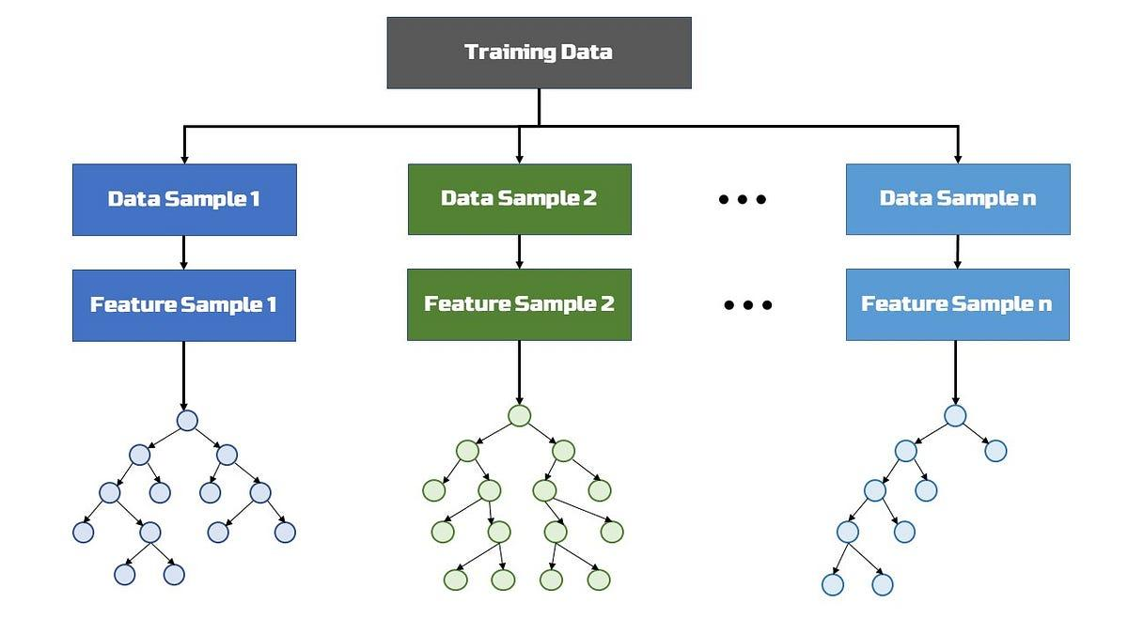
Random Forest
It utilizes bagging to train multiple decision trees.
It extends bagging but splitting the features (columns) as well.
  It splits both samples (rows) and features (columns).
Idea: Multiple Decision Trees are trained on various combinations of observations and features.
Benefits (For large number of trees):
  Improves generalization.
  Becomes robust to outliers (extremely uncommon inputs) & noisy observations.
  Usually works well for classification tasks with small amount of observations.

Slide 8
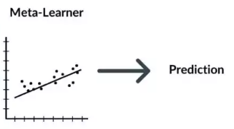
Stacking
Idea: Different models (algorithms) extract different patterns from each dataset, which result in different predictions. A meta-learner (new model) can then be trained to utilize these predictions and estimate the final output.
Meta-learners are typically simple models, such as Linear Regression or Logistic Regression that are trained using the outputs of each trained model.
Similar to voting, but utilize an ML method to combine the outputs, instead of hard/soft voting.
Meta-Learner (Estimator)
Input: ModelA(x), ModelB(x), ModelC(x)
Output: Target y

Slide 9
Boosting
Boosting enables weak ML models to improve their prediction accuracy and become strongers.
Initially, the boosting algorithm assigns equal weight to each data sample (row). It feeds the data to the first model (weak learner). The base algorithm makes predictions for each data sample.
Then, the boosting algorithm assesses model predictions and increases the weight of samples with a more significant error (samples which the learner produced high error). It also assigns a weight based on model performance. A model that outputs excellent predictions will have a high amount of influence over the final decision.
Next, the algorithm passes the weighted data to the next decision tree.
The process is repeated until the training errors fall are below a certain threshold.

Slide 10
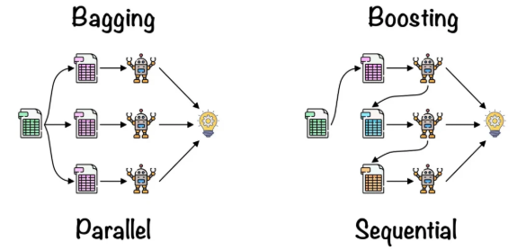
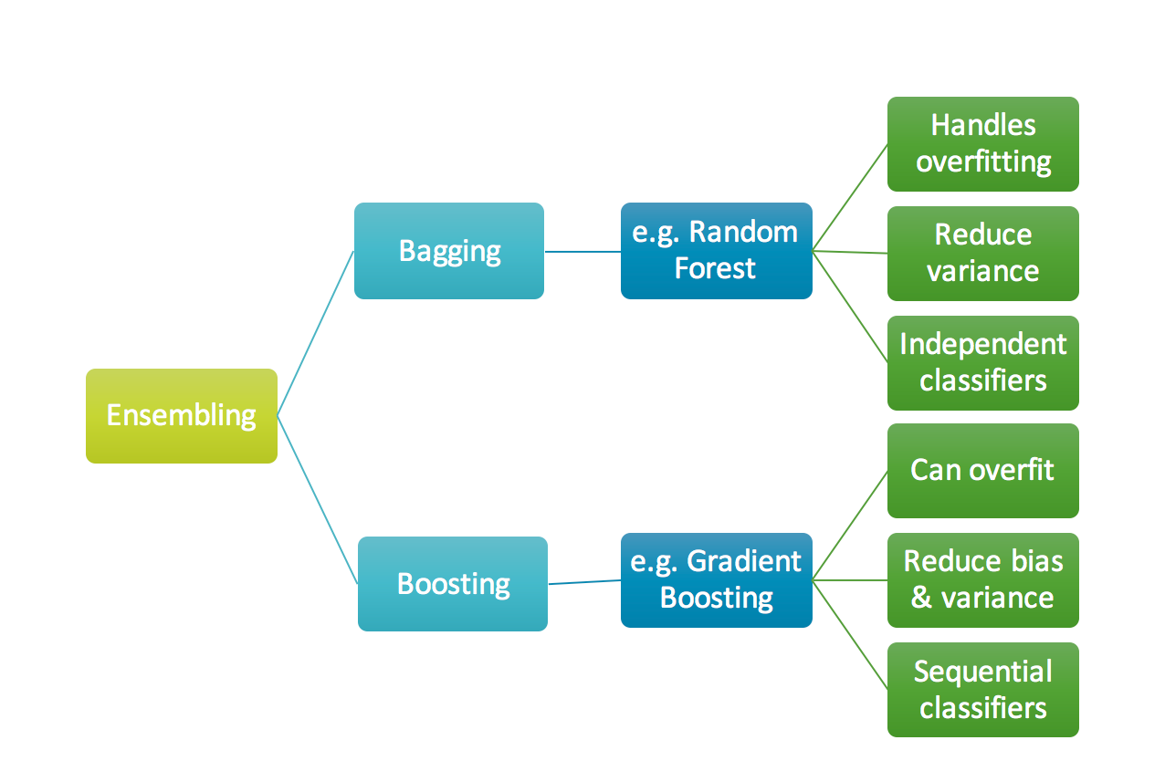
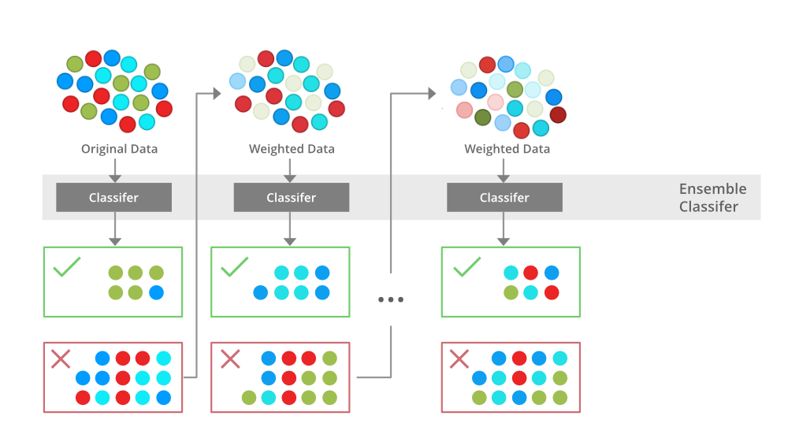
Bagging vs Boosting
Boosting Algorithm

Slide 11
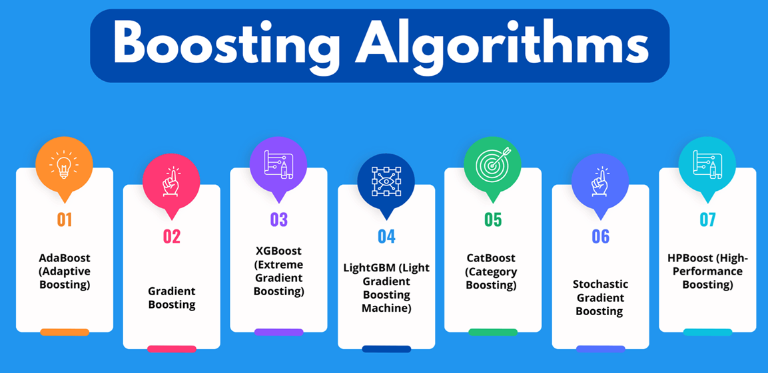

Slide 12
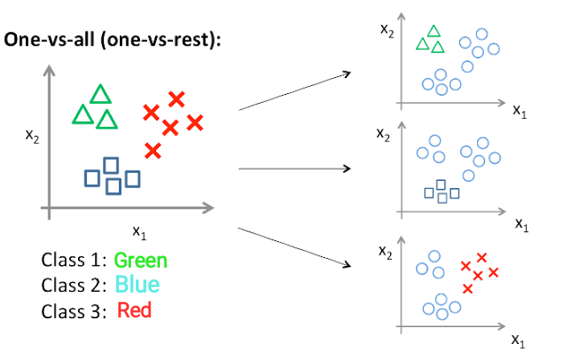
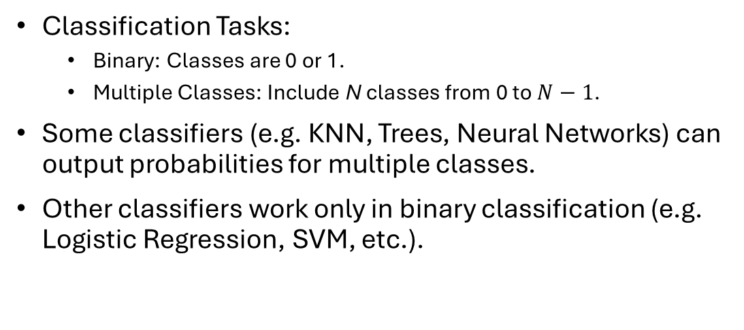
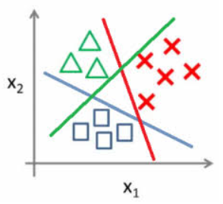
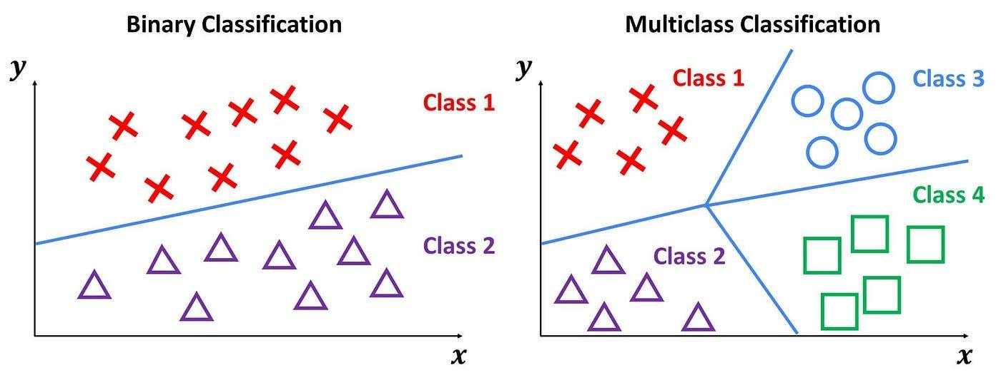
Multi-Class Classification
One vs One

Slide 13
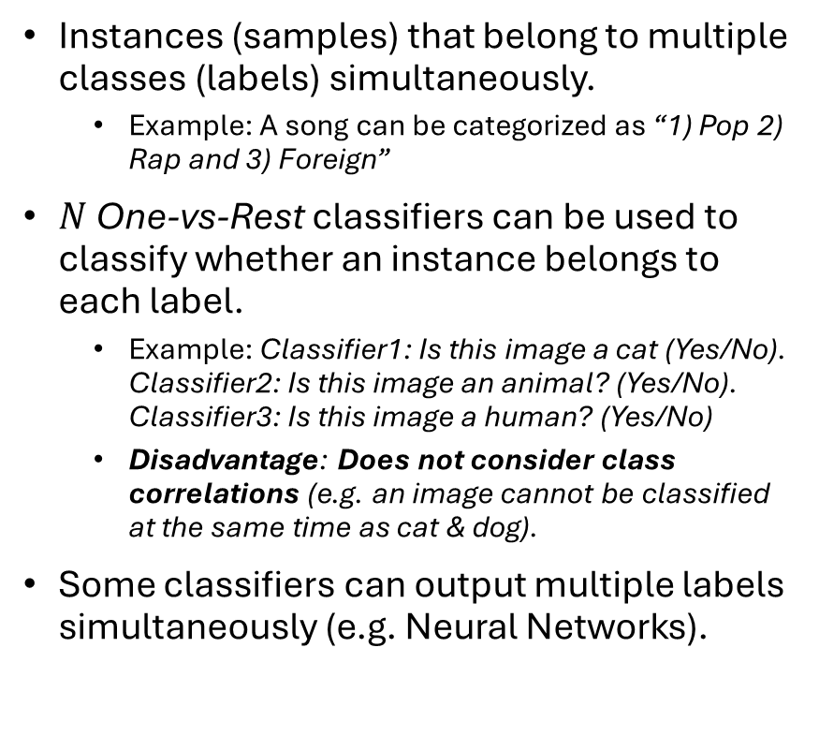
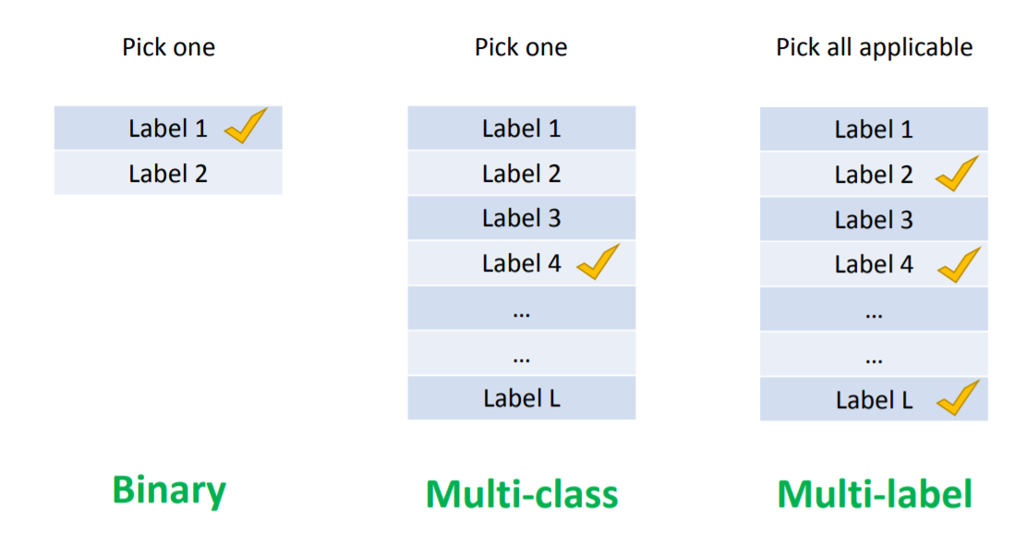
Multi-Label Classification

Slide 14
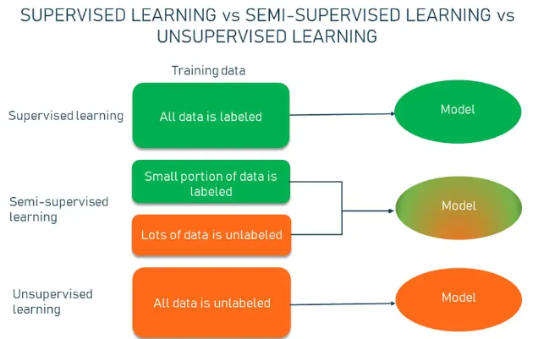
Semi-Supervised Learning
Labeled data are required to train supervised learning models.
Hiring contractors to label large amounts of samples is expensive.
Usually, labeling can be performed for a small portion of data.
There is ton of unlabeled data on internet (e.g. Videos from YouTube, Text from Reddit, etc.).
Semi-Supervised Approaches: Train supervised learning models using both labeled and unlabeled data.

Slide 15
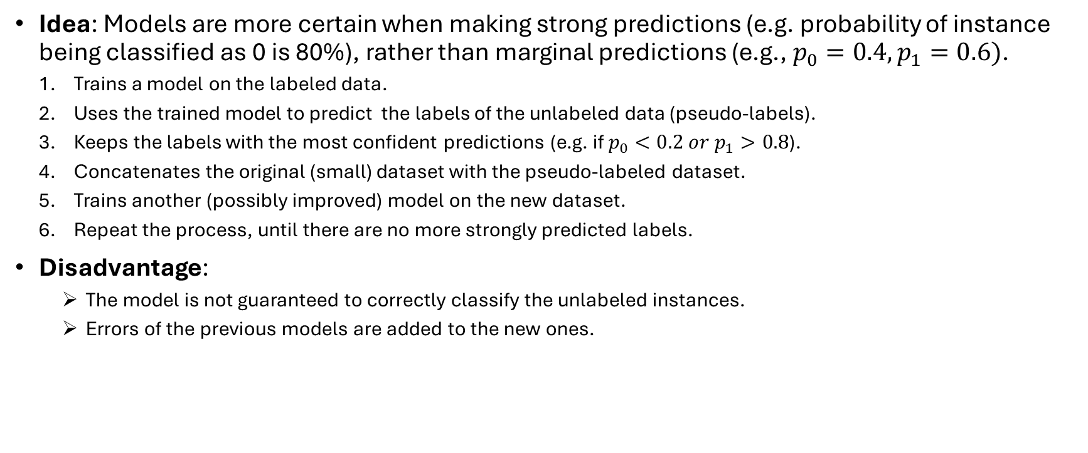
Self-Training

Slide 16
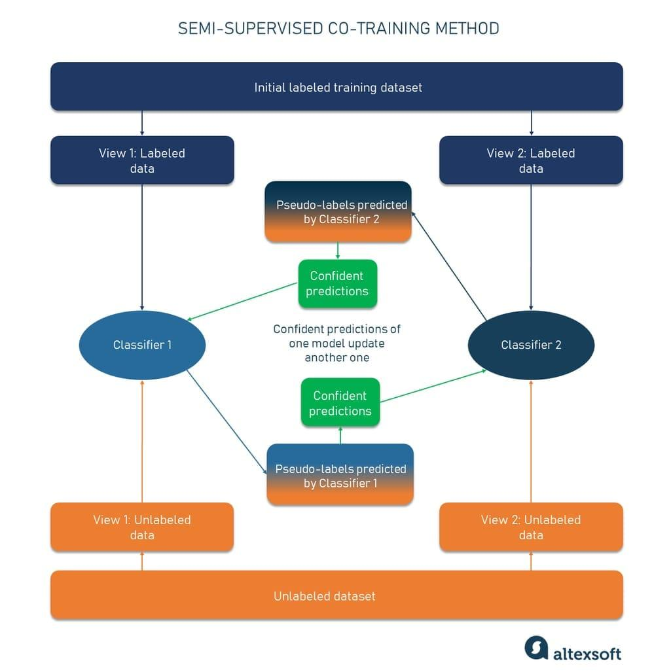
Co-Training
  Similar to self-training, but it utilizes 2 separate classifiers.
  Each classifier is trained on a different set of data (similar to how bagging works).
  The strong predictions of each classifier are added to the dataset of the other classifier.
  Finally, both models are combined (e.g. voting) to classify a new instance.

Slide 17
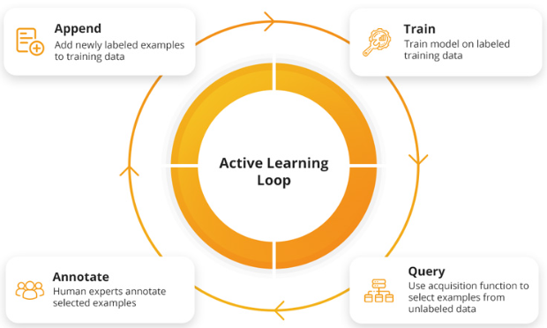
Active Learning
Attempts to train models using the least possible amounts of labeled data using an online training method of multiple training iterations.
At each training iteration, a model selects a subset of samples (using some methods). Then, an expert is called to label these samples.
The labeled samples are added to the dataset and the process repeats, until the model achieves a satisfying performance.
Advantages:
  There are no pseudo-labels, which could be mis-classified, as human experts are involved.
  Requires only a small amount of data labeling.
  The model can carefully select new samples (e.g., unusual samples with low prediction confidence).
Disadvantages:
  Requires experts that train the model online.

Slide 18
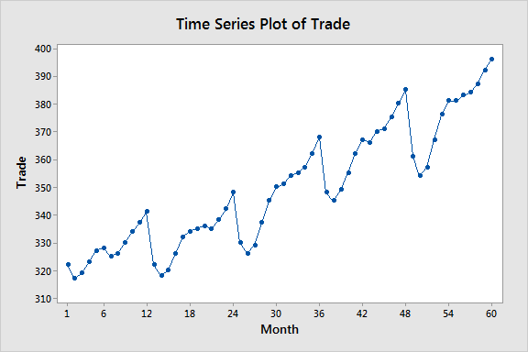
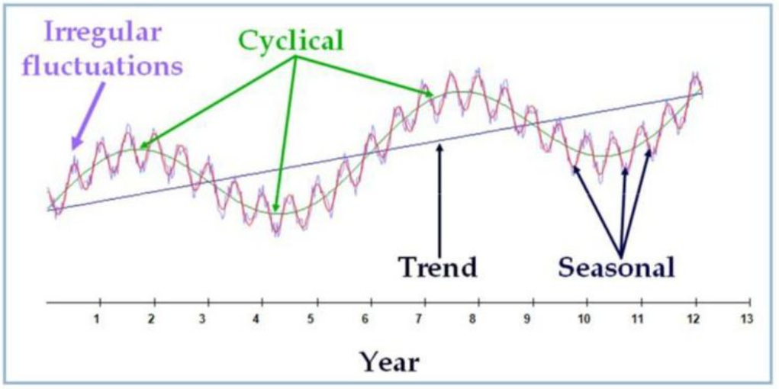

Time Series
Sequential data points (time-dependent variables). Typically, these data points appear within a fixed frequency (e.g., at hourly or daily intervals).
  Examples: Sales per month, temperature per hour, etc.
  Most companies work with sequential data.
Timeseries Analysis:
  Trend: Whether the values increase or decrease (move away from the average) or remain around the average over a specified period.
  Seasonality: Typical shifts in the trend (e.g., the temperature increases every summer, while it decreases during winter).
  Cyclicality: Unusual shifts in the trend, without obvious patterns (e.g., Cryptocurrency trend shifts).
  Irregularity: Small increases or decreases of the variable that cannot easily be explained (e.g., noise).

Slide 19
Timeseries Analysis Challenges
Estimating a time-dependent variables is difficult.
The values depend on time periods (e.g., summer has high temperatures, while winter has lower temperatures).
The values could be correlated to external factors (e.g., a supermarket leaflet could increase the sales on dairy products. Even worse, a war could increase the prices of all products, which in turn can potentially reduce the sales of a supermarket).
Time series is a stochastic process (e.g., the current price of a stock can affects its future price as well).

Slide 20
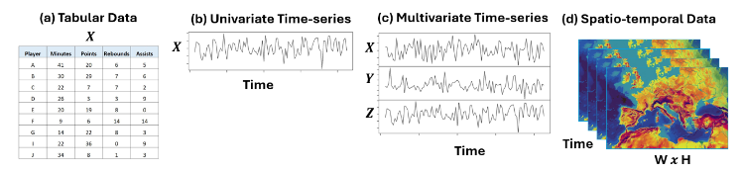
Timeseries Types
Univariate: Only a single time-dependent variable is observed.
Multivariate: Multiple time-dependent variables are observed.
Spatio-Temporal Data: Multi-Dimensional variables that depend both on time and space (e.g. video frames, sound waves, etc.,).
Covariates: External factors (both time-dependent and non time-dependent) that are observed along with the timeseries.
  Example: When predicting the sales of a supermarket, information about leaflets, events (such as holidays), weather, etc., that could affect the sales, are considered covariates and can be utilized to predict the sales of the next interval.

Slide 21
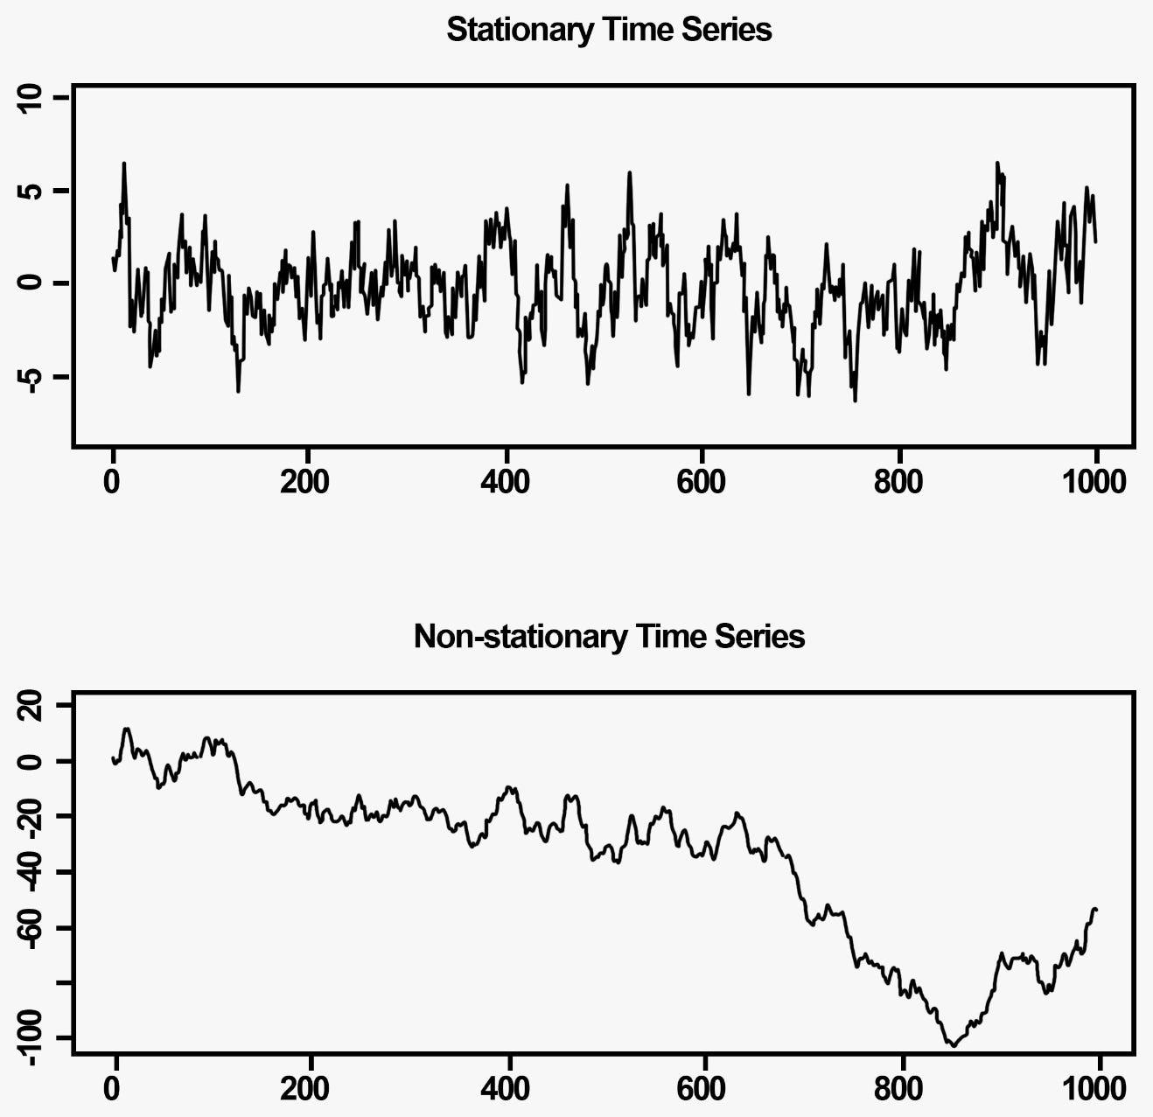
Stationarity
Non-stationary: A time series which constantly shifts its value away from the average. The standard deviation (std) could also change constantly.
Stationary: A time series whose value stays around the average. The standard deviation remains the same as well.
It’s always easier to estimate stationary values, than non-stationary.
Example: When training a model on non-stationary timeseries, the model will learn to predict values around the mean value. If the mean value of the observed value changes, the model will probably fail to predict around the new mean value.
Stationary timeseries remain around to the mean constantly

Slide 22
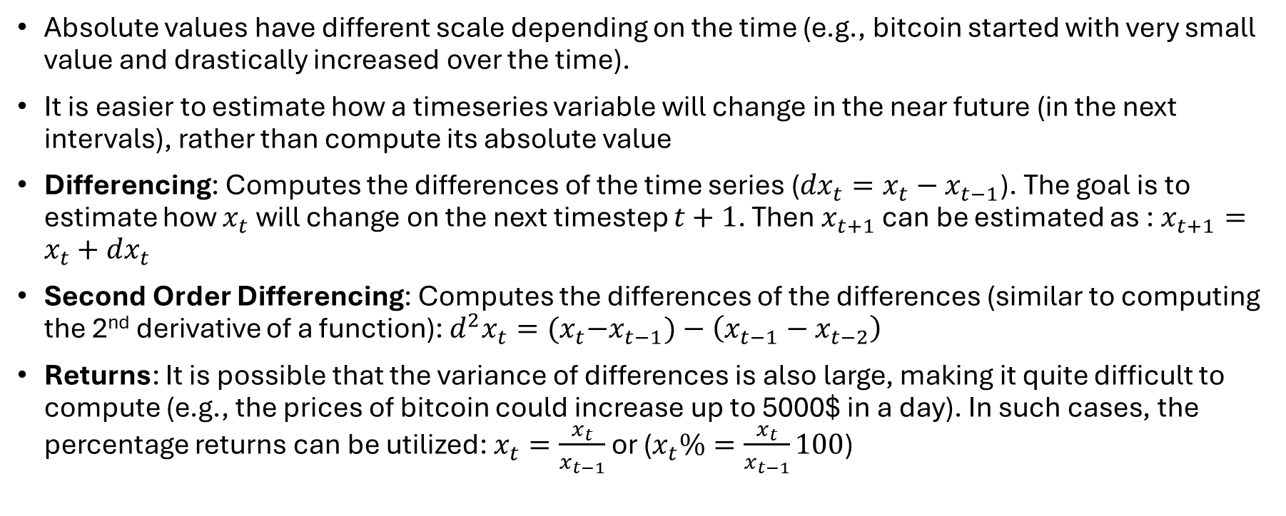
Non-Stationary to Stationary

Slide 23
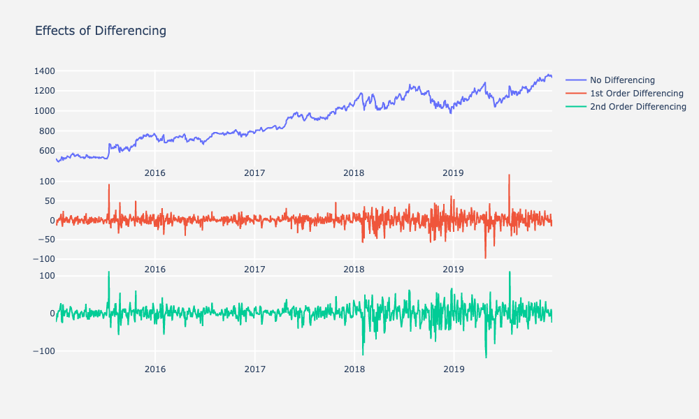
Effects of Differencing

Slide 24
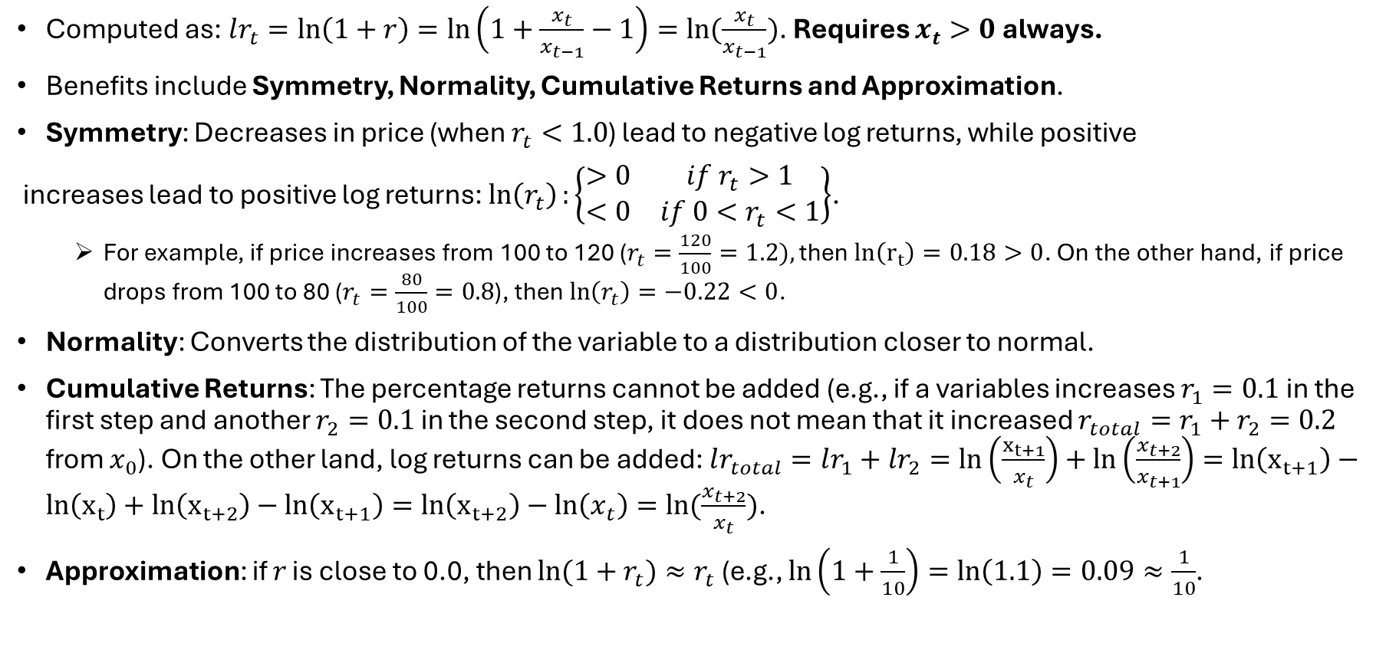
Log Returns

Slide 25
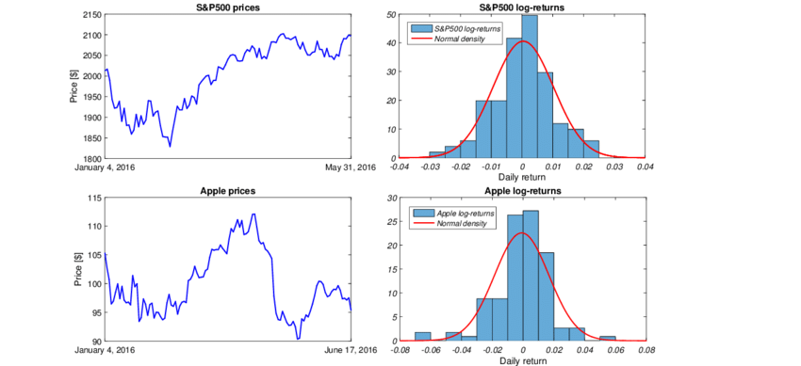
Effects of Log Returns

Slide 26



Time Series Forecasting Methods
2 common methods to estimate time series:
  Statistical Methods
  Machine Learning (ML) Methods
ML methods learn to discover patterns inside a given timeframe.
Timeframe: A window (of size N) of time series observations along with their covariates.
If ML algorithms support only vectors as inputs, the timeframe inputs must be converted to vectors.
Timeframe

Slide 27
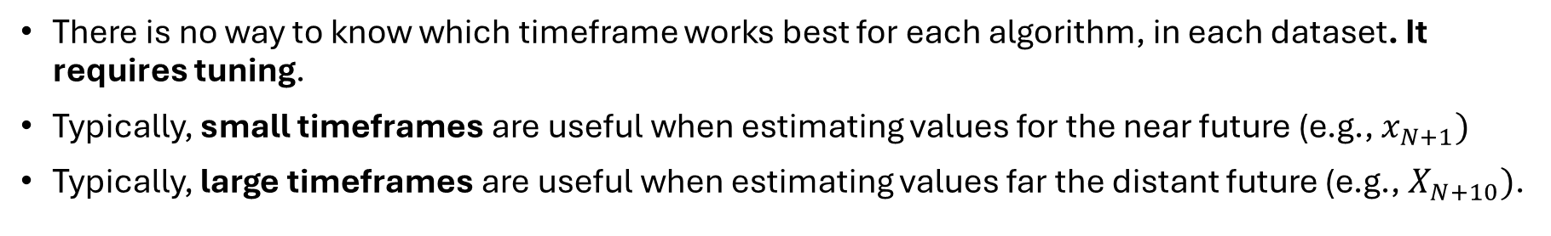
Timeframe Window Selection
Discovers patterns for the near future
Discovers patterns for the distant future

Slide 28
Machine Learning
Ensemble Methods & Time Series Notes

